Slide 1
DXF File
CAD tool to define what to clean
G Code
Convert to ideal G-Code
Calibrate
Align laser to Carousel targets
Adjust
Apply offset and rotation
Clean
Run adjusted G code

Slide 2
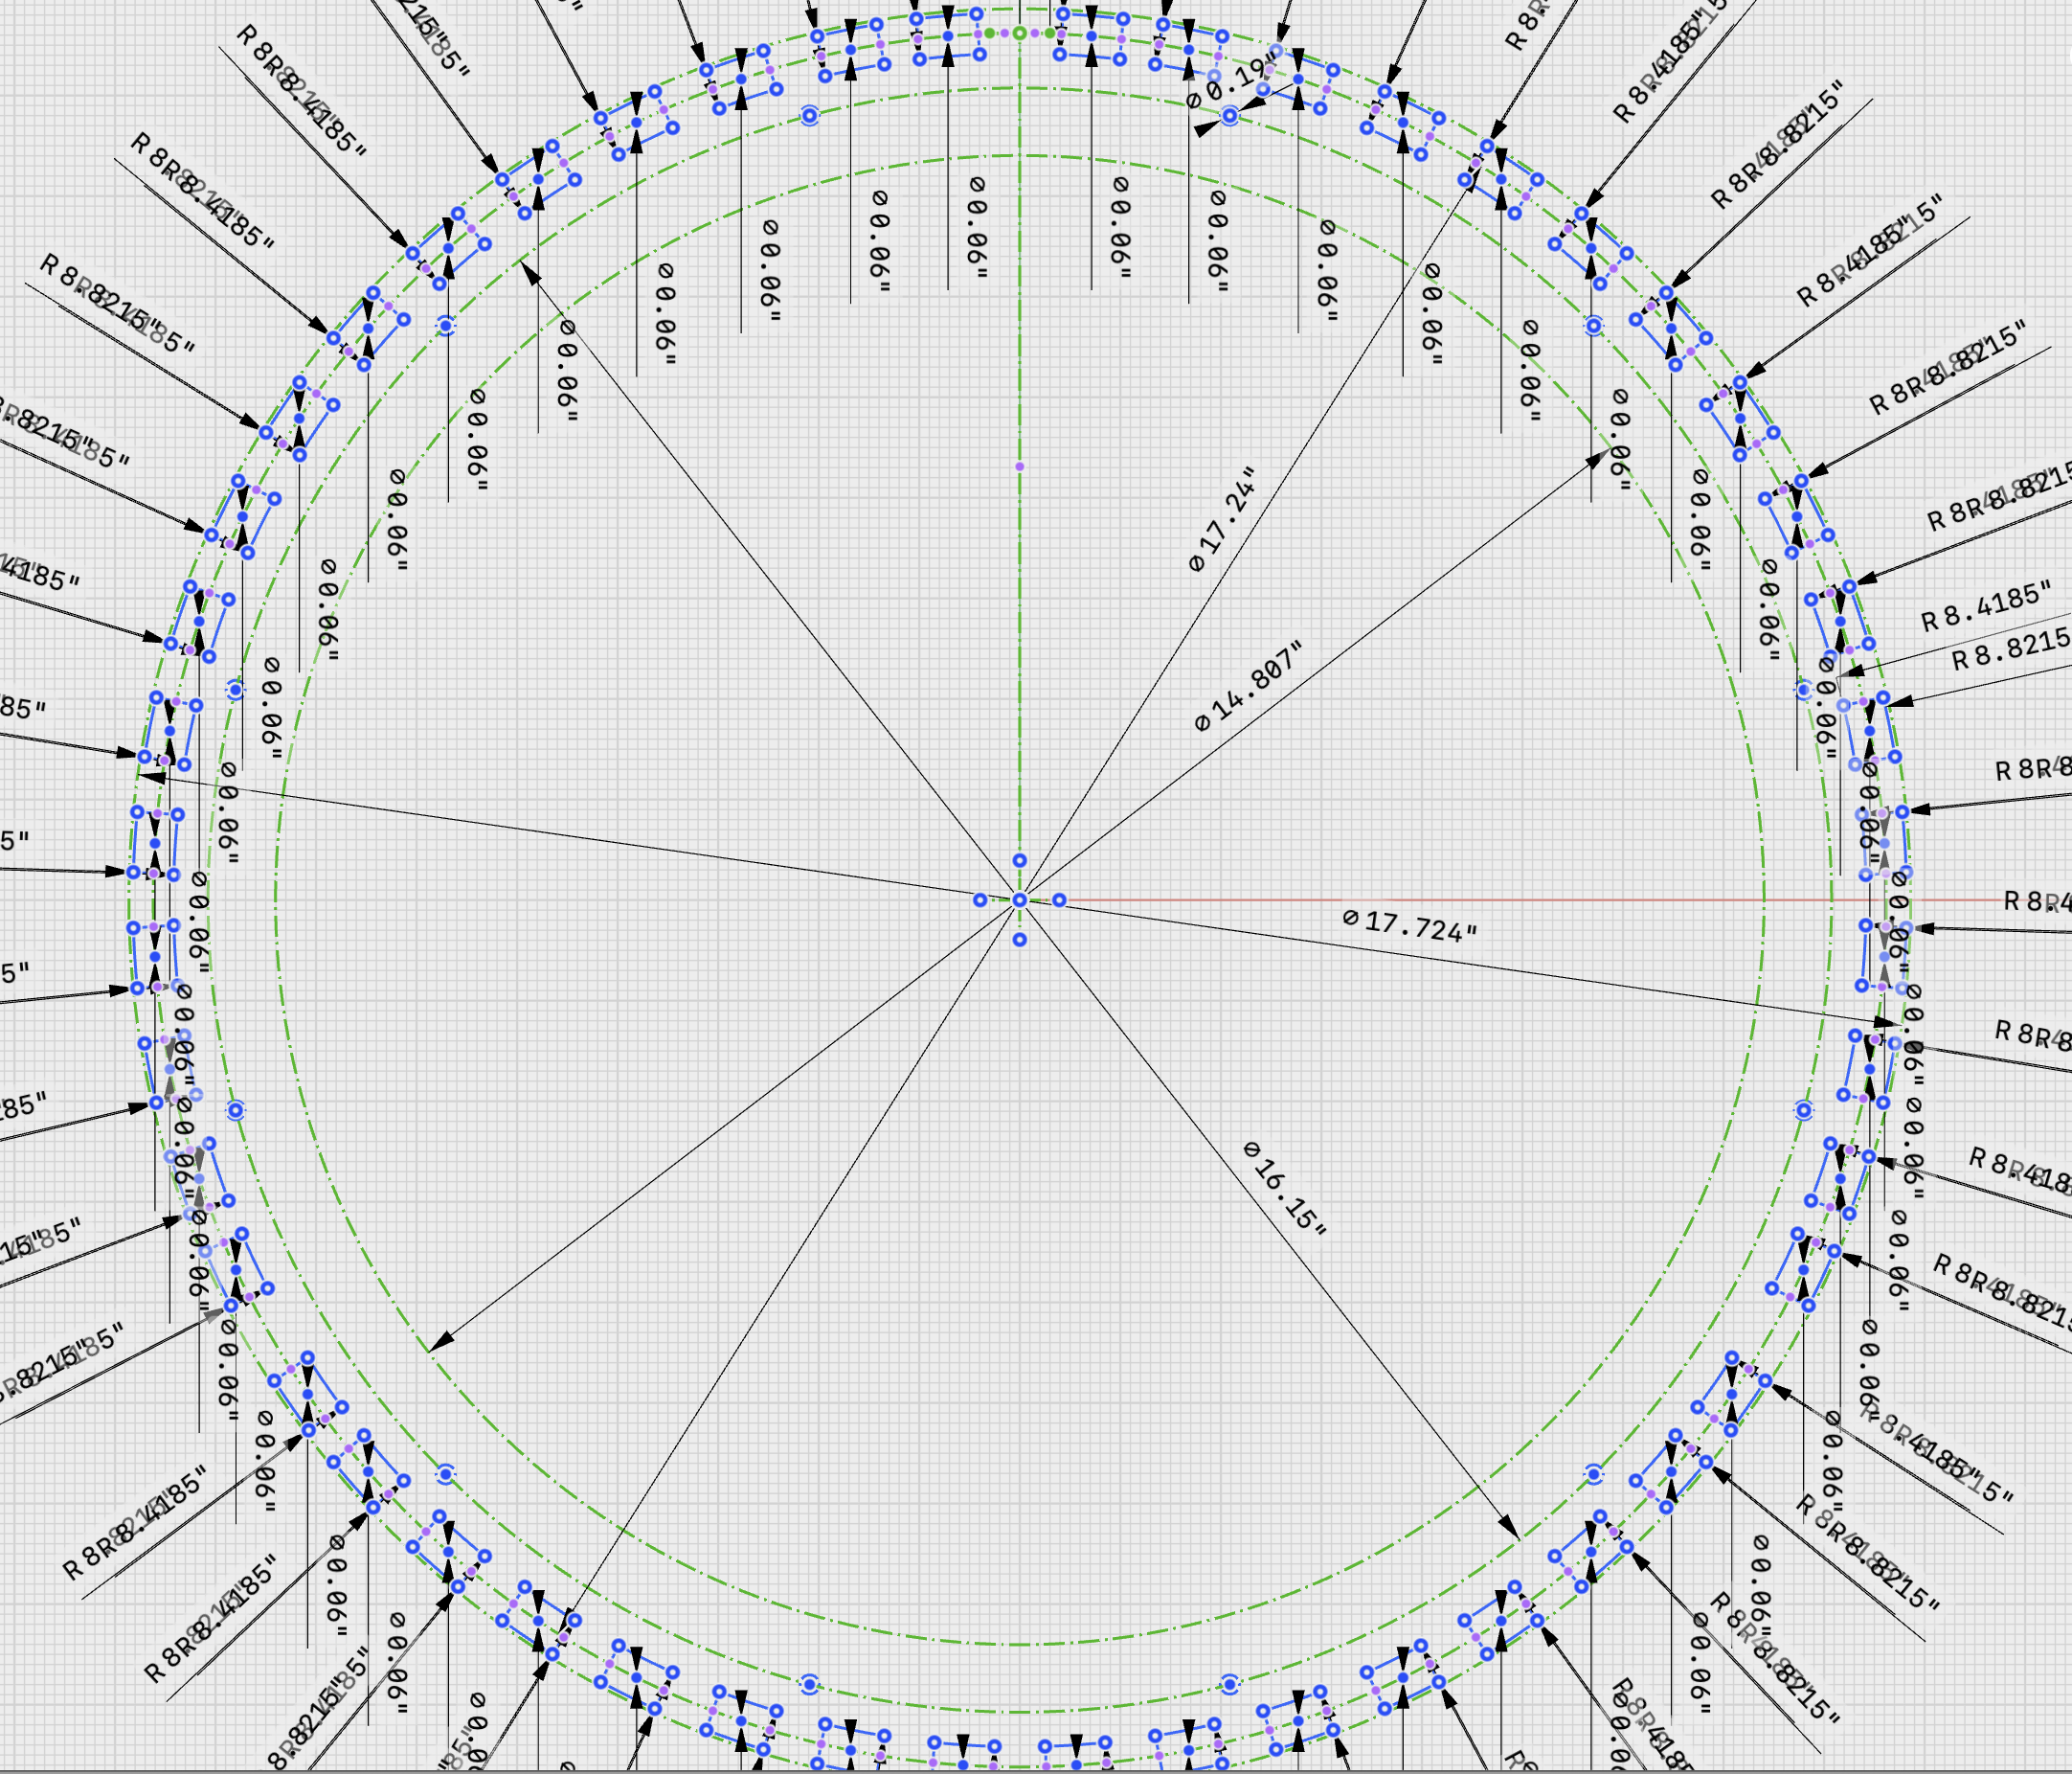
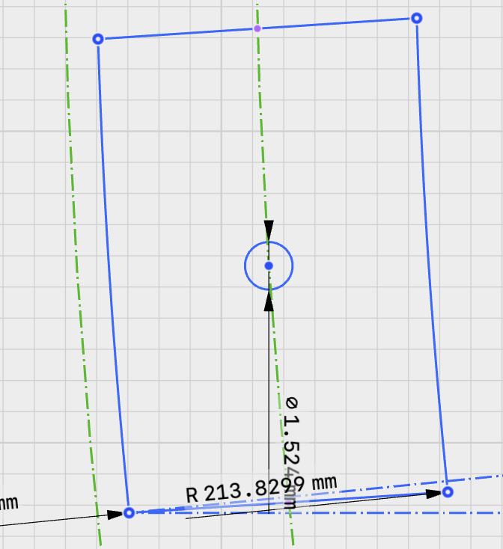
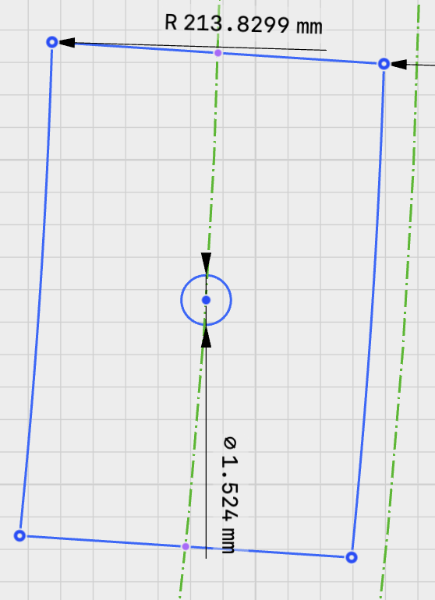
Calibration points
Y axis
The outer lower corner of each circled pad is used for the calibration adjustment. The ideal position of these points relative the DXF file origin is:
Left point: -222.959, -22.250 (Section 3 Pad 4)
Right point: +222.959, -22.250 (Section 1 Pad 13)
Distance from center 224.066 mm
X axis

